Slide 1
Let’s Talk About Your Guns
Preventing Suicide Through Personal Firearm Safety
James C. West, MD
Associate Professor of Psychiatry
Center for the Study of Traumatic Stress
Uniformed Services University

Slide 2
Disclaimer/Conflicts of Interest
The opinions and assertions expressed herein are those of the speaker and do not necessarily reflect the official policy or position of the Uniformed Services University or the Department of Defense.
Neither I nor my family members have a financial interest in any commercial product, service, or organization associated with this presentation.

Slide 3
Objectives
1
2
3
Recognize the relationship between personal firearms, safety practices, and risk of suicide and injury in the home.
Apply safe storage principles in your own home.
Get motivated to have conversations about secure storage of personal firearms.

Slide 4
Firearms, Suicide Risk, and Safe Storage

Slide 5
Suicide Prevention
Take a moment to reflect.
What do you need to do to prevent suicide in your command?

Slide 6
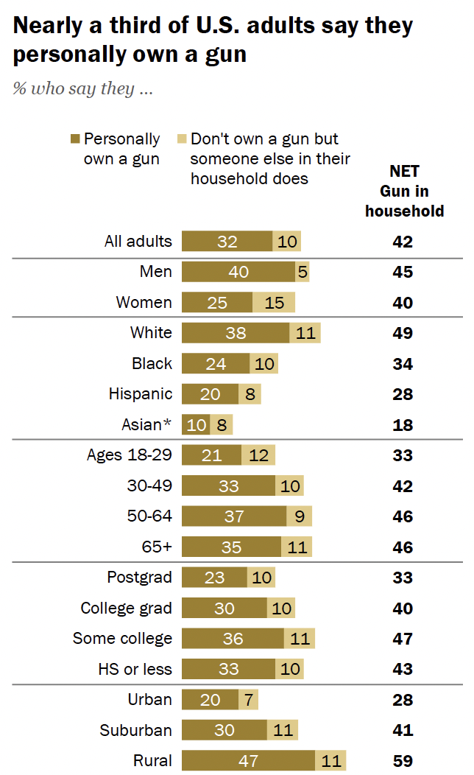
Firearm Ownership in the U.S.
Percent who say they…
Source: Pew Research Center, 2023

Slide 7
Firearm Commerce in the U.S.
Year | Guns Manufactured | Guns Exported | Guns Imported
1986 | 3,040,934 | 217,448 | 701,000
2000 | 3,793,541 | 172,627 | 1,096,782
2018 | 9,052,628 | 554,237 | 4,305,851
ATF, Firearms Commerce in the United States, 2021

Slide 8
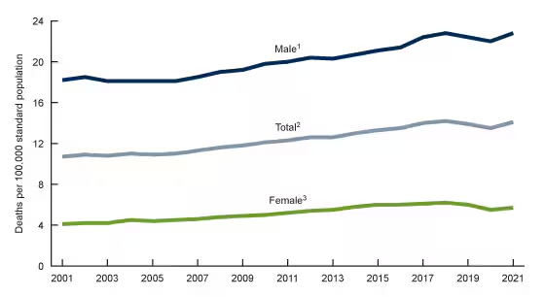
Firearms & Suicide Risk
Suicide - 11th leading cause of death in US (2022)
26,328 suicides (54.6%) by firearm
Firearms are highly lethal
Firearm: 85% fatal
Suffocation (incl. hanging): 69% fatal
Poisoning: 2% fatal
Cutting/Piercing: 1% fatal
CDC, 2023

Slide 9
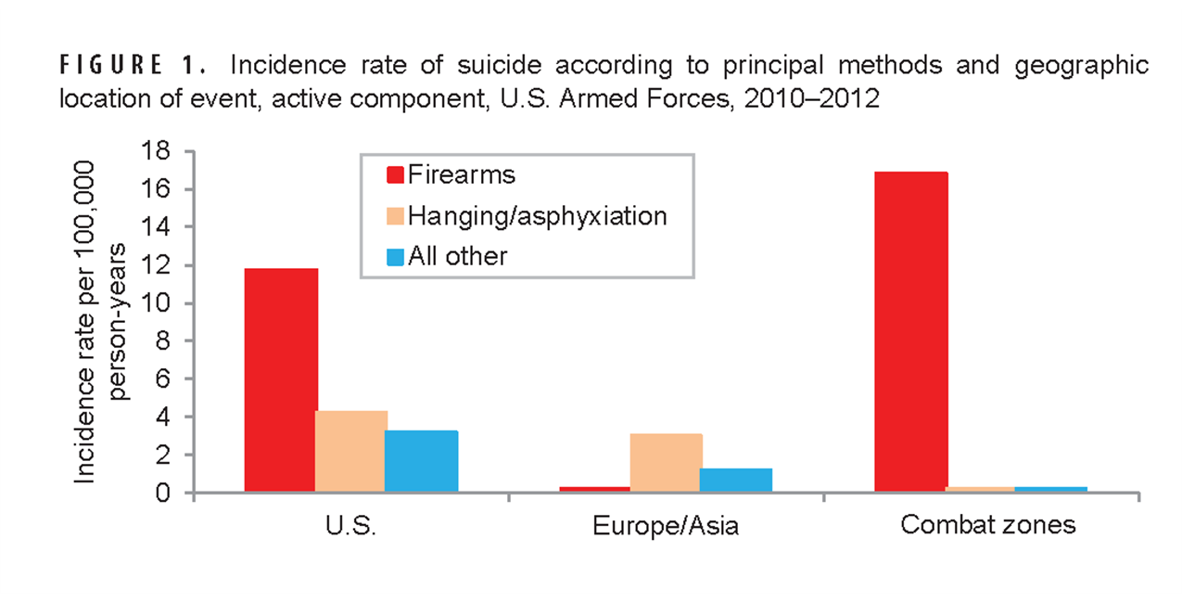
Firearms & Suicide Risk
Corr, MSMR 21(10) Oct 2014

Slide 10
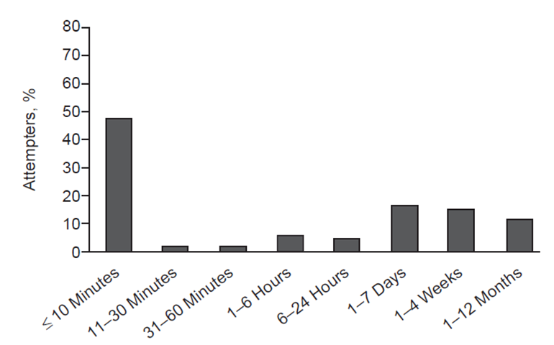
Firearms & Suicide Risk
47.6%
Of attempts occurred within 10 minutes of first thoughts of suicide
Deisenhammer et al. 2009. Journal of Clinical Psychiatry, 70(1):19-24.

Slide 11
Firearms & Risk
“Gun Storage Practices and Risk of Youth Suicide Unintentional Firearm Injuries”
Loaded → 3x more likely to injure
Unlocked → 4x more likely to injure
With ammo → 2-3x more likely to injure
Each individual safety practice reduced risk of injury
Grossman et al. 2005. Gun storage practices and risk of youth suicide and unintentional firearm injuries. JAMA; 293(6):707-714.
Notes:
What public health interventions might make a difference? The following comes from an analysis of youth suicides in Washington state.
It includes 106 cases and 480 matched controls.
Among the cases 84 shootings were suicide attempts and 24 were unintentional injuries.
The control variables included storage of the firearm unloaded, locked storage of gun and ammunition, and storing the gun separate from ammunition.
Each of these practices reduced the risk of injury.

Slide 12
Firearms & Suicide Risk
2152 firearm-owning US adults surveyed in 2022
Gun safes preferred
Cable locks least preferred
Preventing unauthorized access by children from was a motivator
58.3%
Of firearm stored unlocked
Anestis et al. 2023. Assessment of Firearm Storage Practices in the US, 2022. JAMA Network Open.

Slide 13
Engagement and Q&A

Slide 14
Safe Storage Practices

Slide 15
Safe Storage Practices
Take a moment to reflect.
You are driving down a mountain road. As you come around a curve, you spot an icy patch and start to spin.
How will you survive?

Slide 16
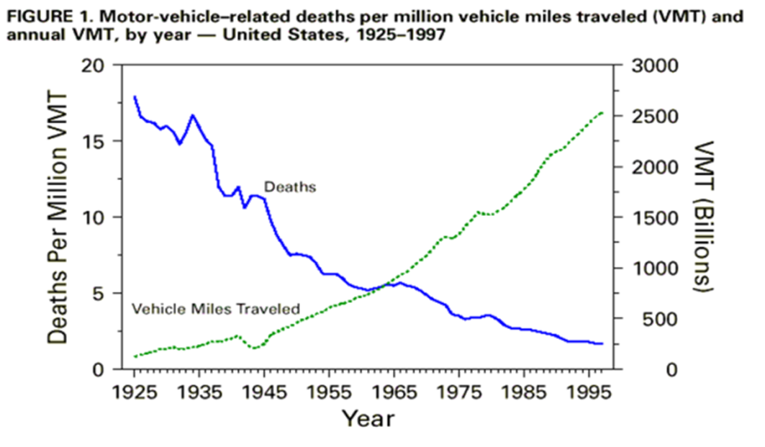
Public Health Approach to Safety
How did we reduce traffic fatalities as we drove more?
Seat belts
Vehicle design
Traffic safety

Slide 17
General Principles of Safe Storage
Firearm is unloaded
Disassembled or properly applied locking device
Locked in a gun safe or secure storage container
Ammunition locked & stored separately
Have an alternate storage plan for times of increased risk
“The four practices of keeping a gun locked, unloaded, storing ammunition locked, and in a separate location are each associated with a protective effect and suggest a feasible strategy to reduce these types of injuries in homes with children and teenagers where guns are stored.”
Grossman et al. 2005. Gun storage practices and risk of youth suicide and unintentional firearm injuries. JAMA; 293(6):707-714.

Slide 18
Alternative Storage Plans
Relative or friend (as long as they are not prohibited by law
Self-storage facility (unloaded)
Police Departments
Gun shops
Pawn shops
Shooting Ranges
Military may turn over to their base armory
Barber, C., (2023) Partnering with Gun Owners to Reduce Suicide.
https://www.hsph.harvard.edu/news/hsph-in-the-news/partnering-with-gun-owners-to-prevent-suicide/

Slide 19
Engagement and Q&A

Slide 20
Talking About Firearms, Risk, and Safety

Slide 21
Talking About Firearms and Safety
Take a moment to reflect.
What are the reasons you don’t talk about safe storage of firearms with your shipmates?

Slide 22
Barriers to the Conversation
“I don’t have the time.”
“It’s none of my business.”
“It’s not going to make a difference.”
“There’s nothing I can do to help.”
“I don’t know much about firearms.”
“I don’t know how to have the conversation.”

Slide 23
How to Talk About Firearms & Safety
Be prepared
Learn about safe storage practices
Consider your own biases and assumptions about firearms and safety
Put yourself in your peer’s shoes before you enter the conversation
Connect, don’t direct
Find out more about your buddy. What is important to them?
Talk about your own safety practices and why they matter to you
Talk in a way that conveys caring and not judgement
Help your buddy brainstorm ideas to feel safe with a gun stored more securely
Notes:
I would like to now shift focus to skills we can apply to encourage others to change their behaviors from less safe to more safe. Some of you may feel very strongly that no risk is acceptable when it comes to firearms in the home. That is not our discussion here. We are focused on how to have the conversation with a peer who has already decided to maintain personal firearms and how we can steer them to safer behaviors.

Slide 24
Let’s Talk About Your Guns
https://www.cstsonline.org/suicide-prevention-program/podcasts/lets-talk-about-your-guns

Slide 25
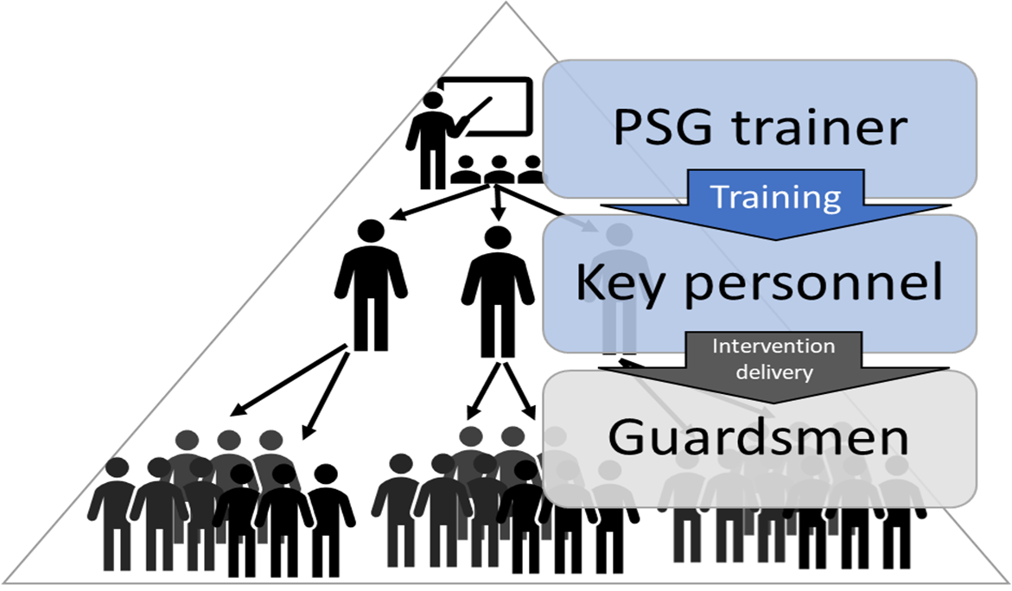
Project Safe Guard

Slide 26
Engagement and Q&A

Slide 27
Summary
Personal firearms are common
Unsecure storage of personal firearms increases risk of death by suicide or injury in the home
Having conversations about secure storage of personal firearms can reduce suicides and contribute to safer homes.

Slide 28
More Resources
Safe Storage Infographic http://www.projectchildsafe.org/safety/safe-storage
Let’s Talk About Your Guns Podcast https://www.cstsonline.org/suicide-prevention-program/podcasts/lets-talk-about-your-guns
Brain Hijack: Science to Practice in Suicide Prevention https://www.cstsonline.org/suicide-prevention-program/podcasts/brain-hijack

